Slide 1
Lesson - 304.3
Data Definition Language
and Data Integrity

Slide 2
Data Definition Language
and Data Integrity Constraints
Learning Objectives:
By the end of this lesson, learners will be able to:
Describe Data Definition Language.
Demonstrate how to create a database in SQL.
Demonstrate how to create tables in a database.
Identify the Data Integrity and Data Types.
Describe Data Integrity and Data Integrity Constraints.

Slide 3
Table of contents
‹#›
Data Integrity
Types of Integrity
Entity
Referential
Domain
User-Defined
Primary Key Constraints
UNIQUE Constraints
Foreign Key Constraints
Delete Actions
Overview of Data Definition Language
Naming Conventions
Create Database in SQL
Create Table in Database
Data Persistence
What is Data Integrity ?
What is Data Integrity Constraints?
1 - Domain Integrity
Domain Integrity - SQL Data Types
Domain Integrity - NOT NULL and DEFAULT Constraints
2 - Entity Integrity
Entity Integrity - Primary Keys
Entity Integrity - Primary Keys for Group of columns
Auto-Generated - Primary Keys
Entity Integrity - UNIQUE Constraints
3 - Referential Integrity
Syntax: Foreign Key Constraints
4 - User-Defined Constraints
Alter Table Statement
Rename Table Name
Drop Table Statement
A Universally Unique Identifier

Slide 4
Introduction to Database Integrity and Constraints
Scenario: When authorized users make changes to the database, integrity constraints ensure that the data remains consistent. When designing the database schema, integrity constraints are added. It defines constraints in SQL DDL commands such as 'CreateTable' and 'AlterTable.'
Integrity Constraints are the protocols that a table's data columns must follow. These are used to restrict the types of information that can be entered into a table. This means that the data in the database is accurate and reliable. You may apply Integrity Constraints at the column or table level. The table-level Integrity Constraints apply to the entire table, while the column level constraints are only applied to one column."
We will explore in detail about Database integrity and constraints in upcoming slides, we will utilize classicmodels database for demonstrations and examples. You must have classicmodels database setup.

Slide 5
Data Definition Language
Data Definition Language (DDL) helps you to define the database structure and schema (tables, table fields, table constraints, and data integrity).
The DDL statements are CREATE, ALTER, and DROP.

Slide 6
Naming Conventions
Before creating a database and tables, consider best practices around table names:
Use real words (non-cryptic): xdsffbus
The name should indicate the purpose, example: trainingFeedback
Avoid dated names: db2012
Avoid special characters: db@fms
Avoid numbers: db007

Slide 7
Create Database in SQL
To create a new database in SQL, you can use the CREATE DATABASE statement with the following syntax:
CREATE DATABASE [IF NOT EXISTS] database_name
[CHARACTER SET charset_name]
[COLLATE collation_name]
Example:
Create database IF NOT EXISTS demoDatabase;
A RDBMS creates a new tablespace named demoDatabase. Some vendors instead support the schema keyword as shown below:
Create schema IF NOT EXISTS demoDatabase;
[IF NOT EXISTS]
[CHARACTER SET charset_name]
[COLLATE collation_name]
All of the above clauses are optional.
If you skip the CHARACTER SET and COLLATE clauses, MySQL will set the default CHARACTER SET, and COLLATE for the new database.

Slide 8
Create a Table in Database
The CREATE TABLE statement allows us to create a new table in a database.
Table definitions define the table name and fields within the table, and the constraints/relationships for the fields. Below is the syntax and an example.
Syntax
Example
CREATE TABLE [IF NOT EXISTS] table_name(
column_1_definition,
column_2_definition,
...,
table_constraints
) ENGINE=storage_engine;
CREATE TABLE vehicles (
vehicleId INT,
year INT NOT NULL,
make VARCHAR(100) NOT NULL
);
Defines a table named “vehicles,” which holds three fields.
[IF NOT EXISTS]
ENGINE=storage_engine;
Both clauses above are optional.
To learn more about Storage Engine, visit the Wiki document.

Slide 9
Data Persistence and Longevity
‹#›
Databases are intended to accrue information over long periods of time. In many cases, the data becomes increasingly valuable as it contains hidden trends and associations, which are not evident in the short-term.
Designing a database with well-chosen constraints on data relationships and values is the best means for maximizing this value.

Slide 10
Data Integrity
‹#›
Data integrity refers to the accuracy, maintenance and consistency of data stored in a database, and is a critical aspect to the design, implementation, and usage of any system that stores, processes, or retrieves data. Data with “integrity” is said to have a complete structure, (e.g., all characteristics defining the data are correct).
To be most useful, data needs to meet the basic criteria. For example:
What use is a “primary key” if a table permits duplicate keys?
What does it mean if an Orders table references a Customers table through a foreign key, but some of those customers are missing?
What good is an Employee table if names are null?
Is abcd+xyz.3# a valid entry for a customer email address?
Do we want to allow “alien” in a column specifying gender?
Databases give us powerful tools to enforce data integrity.

Slide 11
Data Integrity Constraints
‹#›
Enforce Data Integrity by Database Constraints
Data integrity constraints refer to the rules and policies applied to maintain the quality of data.
Data integrity constraints often include checks and corrections for invalid data based on a fixed schema or a predefined set of rules.
Constraints can be classified into two types - column-level and table-level.
There are two main reasons why using database constraints is a preferred way of enforcing data integrity.
First, constraints are inherent to the database engine; thus, uses less system resources to perform their dedicated tasks. We resort to external user-defined integrity enforcement only if constraints are not sufficient to do the job properly.
Second, database constraints are always checked by the database engine before insert, update, or delete operations. Invalid operations are cancelled before the operation is undertaken; therefore, they are more reliable and robust for enforcing data integrity.
continued….
Notes:
a column-level constraint Column-level constraints refer to a single column in the table and do not specify a column name (except check constraints). They refer to the column that they follow.
a table-level constraint Table-level constraints refer to one or more columns in the table. Table-level constraints specify the names of the columns to which they apply.

Slide 12
Data Integrity Constraints (continued)
‹#›
There are four categories of data integrity constraints enforced by a database:
1) Domain Integrity SQL data types NOT NULL constraints Defaults | 2) Entity Integrity Primary keys Unique constraints
3) Referential Integrity Foreign key constraints | 4) User-Defined Integrity: Check constraints Triggers
constraint_expression:
| PRIMARY KEY [index_type] (index_col_name, ...) [index_option] ...
| FOREIGN KEY [index_name] (index_col_name, ...)
REFERENCES tbl_name (index_col_name, ...)
[ON DELETE reference_option]
[ON UPDATE reference_option]
| UNIQUE [INDEX|KEY] [index_name]
[index_type] (index_col_name, ...) [index_option] ...
| CHECK (check_constraints)
Notes:
://dhttpsocs.oracle.com/cd/B19306_01/server.102/b14220/data_int.htm

Slide 13
1 - Domain Integrity
‹#›
Domain Constraints are user-defined columns that help the user to enter the value according to the data type. A data type represents the type of data that can be stored and processed.
SQL Data types comes under Domain Integrity category.
You can find all data types here: https://dev.mysql.com/doc/refman/8.0/en/data-types.html
Notes:
SQL Data types were discussed in a previous presentation.

Slide 14
Domain Integrity - SQL Data Types
SQL Data Types are a part of the language where vendors have diverged. There are, however, a few core types (or type aliases) supported by all vendors:
Data Type | SQL | Details
Numeric, integral | int(size) | size indicates maximum # digits
floating point, high precision | decimal(size, d) | size is the maximum # digits; d is # decimal places
Character | char(size) nchar(size) | Fixed-length character. Unused slots are padded. ‘n’ is unicode.
Character | varchar(size) nvarchar(size) | Variable-length character. ‘n’ is unicode.
Numeric, floating-point | double(size,d) | size is the maximum # digits; d is # decimal places

Slide 15
Domain Integrity - SQL Data Types (continued)
Data Type | SQL | Details
Text |  | A small non-binary string
Binary (images) | BLOB | Binary large object
Date/time | date, datetime, timestamp, year | timestamp is high precision
null | null | •Multiple meanings: •Unknown data. •Inapplicable data. •No value supplied. •Value undefined.
ENUM | emum | An enumeration: Each column value may be assigned one enumeration member.
To learn more about SQL data types, visit the Wiki document.

Slide 16
Domain Integrity Example: SQL Data Types
In this example, we will create tables named payments_info, and we will specify column names with Data Types.
CREATE TABLE payments_info (
customerNumber int,
checkNumber varchar(50),
paymentDate date,
amount decimal(10,2),
is_completed BOOLEAN,
descriptions TEXT,
created_at TIMESTAMP,
price DECIMAL(10,2),
quantity SMALLINT, -- Allow negative
priority ENUM('Low', 'Medium', 'High')
);

Slide 17
Domain Integrity: NOT NULL and DEFAULT Constraints
The NOT NULL constraint prevents the column from having a NULL value; it specifies that a NULL value is not allowed.
When designing tables, it is essential to consider where NULL values are appropriate. Most often, this is a common-sense decision. For example:
Can the first line of an address be NULL?
Can a customer’s surname be NULL?
Can an employee’s date of birth be NULL?
Can feedback provided by a customer be NULL?
Notes:
One expert advises that NOT NULL be used for all columns to avoid confusion

Slide 18
Domain Integrity: NOT NULL and DEFAULT Constraints
Default constraint specifies a default value for a column if no value is supplied when adding a record to a table.
Note: If no DEFAULT is defined, a column defaults to NULL unless there is a NOT NULL constraint; in which case, a value must be provided in the INSERT statement.
DEFAULT values can use the return value of built-in and user-defined functions.

Slide 19
Domain Integrity Example: NOT NULL and DEFAULT Constraints
In the this example, we will demonstrate how to use the NOT NULL constraint and the DEFAULT constraint.
create table Salesfeedback(
customerFeedback varchar(2048) DEFAULT NULL,
createdDate datetime NOT NULL DEFAULT current_timestamp,
customerReference varchar(15) DEFAULT 'OnlineSales',
username varchar(50) NOT NULL
);
current_timestamp is built-in function in SQL.

Slide 20
2 - Entity Integrity
‹#›
Entity Integrity ensures that there are no duplicate records within the table and that the field that identifies each record within the table is unique and never null.
Entity Integrity requires that each row of a table, representing a unique “entity,” can be uniquely identified. It is enforced to use primary key constraints and unique constraints.

Slide 21
Entity Integrity - Primary Keys
Primary key constraints are defined in the CREATE TABLE statement, using either column-level or table-level.
When the primary key constraint is defined for a table, the database will ensure that it is both present (not null) and unique.
One table can only have one primary key, which may consist of a single column or multiple columns. If the primary key contains multiple columns, it is called a composite primary key, and the combination of the multiple columns must contain distinct values.
Remember: It is NOT required for each table to have a primary key constraint.

Slide 22
Example - Primary Key
Example: field-level
Example: table-level
create table department_one(
id int primary key,
name varchar(32) NOT NULL
);
create table department_two(
id int,
name varchar(32) NOT NULL,
constraint pk_dept PRIMARY KEY(id)
);
The constraint keyword + identifier are optional.
The identifier must be unique in the database.
Notes:
a column-level constraint Column-level constraints refer to a single column in the table and do not specify a column name (except check constraints). They refer to the column that they follow.
a table-level constraint Table-level constraints refer to one or more columns in the table. Table-level constraints specify the names of the columns to which they apply.

Slide 23
Entity Integrity - Primary Keys - Groups of Columns
We can specify a group of columns as the primary key by using the table-level.
Syntax:
PRIMARY KEY (col1,col2,...)
Example:
CREATE TABLE Student (
std_id INT,
roll_id INT,
fullname VARCHAR(255),
is_completed BOOLEAN,
PRIMARY KEY (std_id , roll_id)
);

Slide 24
Auto-Generated - Primary Keys
SQL provides mechanisms for generating primary keys. The “AUTO_INCREMENT” attribute can be used to generate a unique identity for new rows when you insert a new record to the table. The AUTO_INCREMENT indicates that the value of the column is incremented automatically, by one, whenever a new row is inserted into the table.
Example
CREATE TABLE checklists (
todo_id INT AUTO_INCREMENT,
task_id INT,
todo VARCHAR(255),
is_completed BOOLEAN,
PRIMARY KEY (todo_id , task_id)
);
Notes:
https://mariadb.com/kb/en/auto_increment/

Slide 25
Universal Unique Identifier
A Universal Unique Identifier (UUID) is a generated number that is globally unique even if it is generated by two independent programs on different computers.
The probability that a UUID is not unique is close enough to zero to be negligible.
A UUID is generated from a timestamp (temporal difference) and computer node ID (spatial difference).
A UUID value is a 128-bit number, and can be used to create a primary key in a distributed environment.
To generate UUID values, use the UUID() function: UUID()
Example: SELECT UUID() AS UUID_Value
For more information about UUID, visit the Wiki document

Slide 26
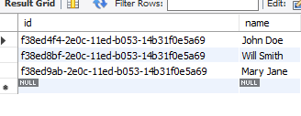
Example - SQL Universal Unique Identifier
Let’s take a look at an example of using UUID as the primary key. The following query creates a new table named account.
CREATE TABLE account (
id varchar(130) PRIMARY KEY,
name VARCHAR(255) );
To insert UUID values into the id column, we can use the UUID() function as follows:
INSERT INTO account(id, name)
VALUES(UUID(),'John Doe'),
(UUID(),'Will Smith'),
(UUID(),'Mary Jane');
Let’s query data from the account table.
Result
SELECT id, name FROM account;

Slide 27
Entity Integrity - UNIQUE Constraints
A field created with the UNIQUE constraint resembles a primary key – all values for that field must be unique – no duplicates are allowed.
Like primary keys, a UNIQUE constraint can apply to compound fields, which means that each combination of those fields must be unique. Unlike primary keys, NULL is allowed, and you can have many UNIQUE constraints per table.
Sometimes, the data in a column must be unique, even though the column does not act as PRIMARY KEY of the table. For example, the CategoryName column is unique in the categories table, but CategoryName is not a primary key of the table. In this case, we create a UNIQUE constraint, which determines that the values in a column or columns must be unique.

Slide 28
Example - UNIQUE Constraints
CREATE TABLE productcategories (
productId INT AUTO_INCREMENT,
productCode varchar(255),
productname varchar(50) UNIQUE,
CategoryName varchar(15) UNIQUE,
PRIMARY KEY (productId, productCode)
);
A good business practice: In the example above, all of the product names and category names must be unique.

Slide 29
3 - Referential Integrity
Referential Integrity is about enforcing the relationships defined between tables. This is done with “Foreign Key” constraints.
The table with the foreign key can be called a child table, referencing table, or foreign key table. The table with the primary key can be called parent table, referenced table, or primary key table.
Foreign Key constraints are defined at the table level.
NOT NULL is not required. Sometimes, it makes sense to allow a NULL Foreign Key.
Notes:
Null foreign keys make sense. For example, when there is a self key in the employee table pointing to an employee’s manager. The top-level employee (e.g., President) has no manager, so has a null foreign key.

Slide 30
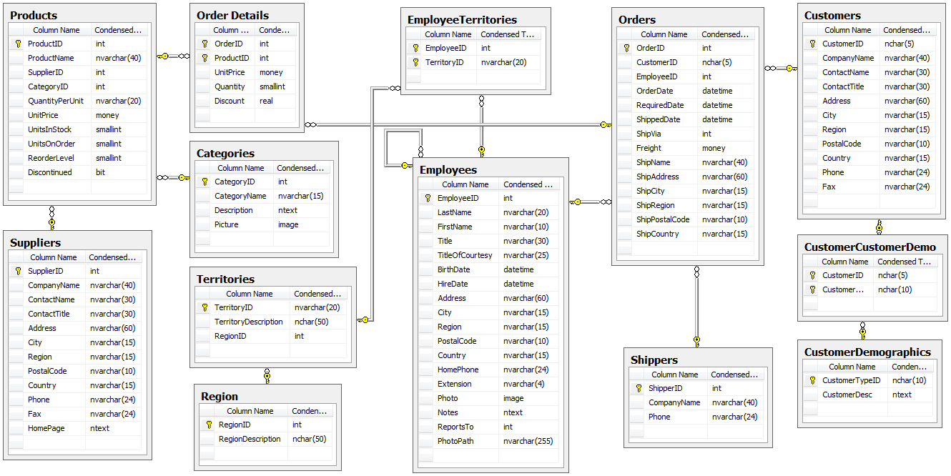
Referential Integrity - Foreign Keys
Foreign Keys define relationships between tables.

Slide 31
Syntax: Foreign Key Constraints
Foreign Keys are created with a CREATE TABLE or ALTER TABLE statement. A table can have multiple foreign keys that refer to the primary keys of different parent tables. The definition must follow this syntax:
Create table tablename
Column_Name Datatype
[CONSTRAINT [identifier] FOREIGN KEY [Column_Name]
REFERENCES tbl_name (index_col_name)
[ON DELETE reference_option]
[ON UPDATE reference_option]
reference_option: RESTRICT | CASCADE | SET NULL | NO ACTION | SET DEFAULT
The reference_option provides actions that SQL will take when values in the parent table are deleted (on delete) and/or updated (on update).
CASCADE | All records related to that key will be deleted from their respective table(s). | set null | All related key fields will be set to null. Records will not be deleted, but the relationship is gone.
SET DEFAULT | All related key fields will assume the default value defined for them, but will only be worked with a PBXT engine. | RESTRICT | A key violation exception will be raised.
Notes:
https://dev.mysql.com/doc/refman/5.6/en/create-table-foreign-keys.html

Slide 32
Example 1: Foreign Key Constraints
With Automatic Delete and Update
Step 1: Create a table as shown below:
Step 2: Create a table as shown below:
CREATE TABLE department (
id INT(10) PRIMARY key AUTO_INCREMENT NOT null,
dname VARCHAR(20) NOT NULL DEFAULT 'pending',
dcode VARCHAR(10) UNIQUE NOT NULL,
depManager VARCHAR(15) DEFAULT "No boss",
depphone INT(7) UNIQUE,
depCreatedDate timestamp,
depstatus ENUM('Active', 'Deactive', 'onhold')
);
CREATE TABLE employee (
empId INT(10) PRIMARY KEY AUTO_INCREMENT ,
eName VARCHAR(10) NOT NULL,
etitle VARCHAR(15) NOT NULL DEFAULT 'employee',
eManagerID INT(10),
eSalary DOUBLE(6, 3),
depID INT(10),
CONSTRAINT depFK FOREIGN KEY(depID) REFERENCES department(id)
ON DELETE CASCADE
ON UPDATE CASCADE
);
The depID in the employee table is the foreign key that references the id column in the department table. For each row in the employee table, you can find a corresponding row in the department table.
Notes:
Note: The constraint keyword and identifier(depFK) is optional, but the identifier (if present) must be unique in the database.

Slide 33
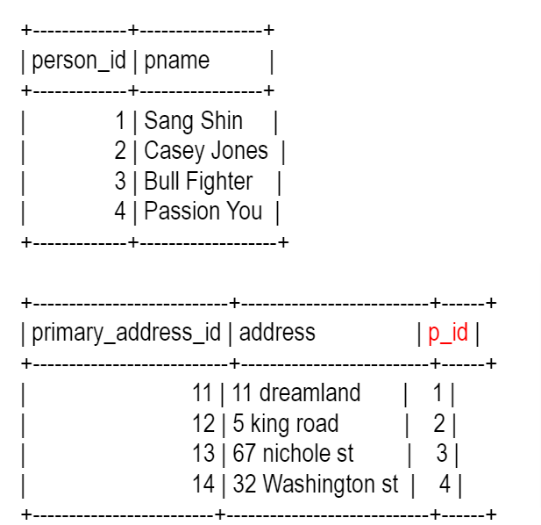
Example 2: Foreign Key Constraints
Without Automatic Delete and Update
Example One-to-One Relationship
A person has only one primary address.
The “person” table has a 1-1 relationship with primary-address table.
The “primary_address” table has a foreign key field referring to the primary key field of the “person” table.
/* Create "person" table */
CREATE TABLE person (
person_id INT NOT NULL AUTO_INCREMENT,
pname varchar(255) NOT NULL,
PRIMARY KEY (person_id)
);
/* Create "primary_address" table with FOREIGN KEY */
CREATE TABLE primary_address (
primary_address_id INT NOT NULL,
address varchar(255) NOT NULL,
p_id INT NOT NULL,
PRIMARY KEY (primary_address_id),
FOREIGN KEY (p_id) REFERENCES person (person_id)
) ;
Notes:
Note, You can use a

Slide 34
Example 3: Foreign Key Constraints
/* Create students table */
CREATE TABLE students (
student_id INT NOT NULL AUTO_INCREMENT,
sname varchar(255) NOT NULL,
PRIMARY KEY (student_id)
) ;
/* Create course table */
CREATE TABLE course (
course_id INT NOT NULL AUTO_INCREMENT,
cname varchar(255) NOT NULL,
PRIMARY KEY (course_id)
);
/* Create "student_course" join table with FOREIGN KEY to both student and course tables. */
CREATE TABLE student_course (
s_id INT NOT NULL,
c_id INT NOT NULL,
PRIMARY KEY (s_id, c_id),
FOREIGN KEY (s_id) REFERENCES students (student_id),
FOREIGN KEY (c_id) REFERENCES course (course_id) );
Example: Many-to-Many (n-m) Relationship
A student takes many courses, and each course has many students.
“student” and “course” have an n-m relationship.
Therefore, we need a “student_course” join table (intersection table) called “student- course.”
The “student_course” table has foreign key fields to both “student” and “course” tables.
The “student_course” table primary key is typically a composite of the student and course primary keys.
The “student_course” table can contains other fields such as “course registration date.”

Slide 35
4 - User-Defined Integrity
We often want to constrain field values in a customized manner. The simplest way to accomplish this is with a CHECK constraint:
The CHECK constraint is used to limit the value range that can be placed in a column.
If you define a CHECK constraint on a column, it will allow only certain values for this column.
If you define a CHECK constraint on a table, it can limit the values in certain columns based on values in other columns in the row.
Example:
create table sale(
saleId int PRIMARY KEY,
locationId int NOT NULL,
amount decimal check(amount >= 10.0)
);
This constraint enforces a minimum sale of 10.00 currency units.

Slide 36
Example 1: CHECK Constraints
In this statement, we have two column CHECK constraints; one for the cost column and the other for the price column.
Step 1
CREATE TABLE parts (
part_no VARCHAR(18) PRIMARY KEY,
description VARCHAR(40),
cost DECIMAL(10,2 ) NOT NULL CHECK (cost >= 0),
price DECIMAL(10,2) NOT NULL CHECK (price >= 0)
);
Step 3
INSERT INTO parts(part_no, description,cost,price)
VALUES
('A-001','Cooler color is black',10,100);
Step 2
INSERT INTO parts(part_no, description,cost,price)
VALUES('A-001','Cooler',0,-100);
The above insert query will execute successfully.
The above insert query will give an Error because the value of the price column is negative. Expression (price > 0) evaluates to FALSE.

Slide 37
Example 2: CHECK Constraints
‹#›
create table modelCar(
carName varchar(20) NOT NULL,
generation varchar(20) NOT NULL,
constraint chk_gene CHECK (generation in ('Antique', 'Classic', 'Modern'))
);
In the above query, the CHECK Constraint ensures that the genre column will be limited to the three given values.
The following query will return errors due to the NON-Antique value for the generation column.
The below query will execute successfully.
INSERT INTO `modelcar`
(`carName`,`generation`)
VALUES('Honda','Antique');
INSERT INTO `modelcar`
(`carName`, `generation`)
VALUES ('Honda', 'NON-Antique');

Slide 38
Alter Table Statement
The Alter Table Statement allow us to change/modify an existing table. We can:
Add a new column.
Drop an existing column.
Modify an existing column.
Add a constraint.
Drop an existing constraint.

Slide 39
Alter Table - Examples
-- Add new column in customer table.
alter table customers add dob date default null;
-- Drop phone column from customers_new table
alter table customers_new drop phone;
-- Modify the data type of comments column in the orders table.
alter table orders modify comments varchar(2000);
-- Add multiple columns to the vehicles table.
alter table vehicles
ADD color VARCHAR(50),
ADD note VARCHAR(255);
Note: Refresh your tables after running these queries to see the results in MySQL Workbench.
Notes:
Note: all above table we have already created in previous lab and examples

Slide 40
Rename Table Name
MySQL offers two ways to rename tables.
The first one uses the ALTER TABLE statement syntax:
ALTER TABLE old_table_name RENAME new_table_name;
The second way is to use RENAME TABLE statement syntax:
RENAME TABLE old_table_name TO new_table_name;
The RENAME TABLE offers more flexibility. It allows renaming multiple tables in one statement. This can be useful when replacing a table with a new pre-populated version:
RENAME TABLE products TO products_old, products_new TO products;
The above statement is executed left to right, so there is no conflict naming products_new to products since the existing table has already been renamed to products_old. Furthermore, this is done automatically.
Notes:
You might be get an error to run the above query , This is just for the example

Slide 41
Example: Rename Table
In this example, we will create two tables, and then we will modify/rename the tables. Run the queries below in the MySql Workbench.
Step 1
Step 2
CREATE TABLE `animalinfo` (
`id` INT,
`name` CHAR(30) NOT NULL
);
CREATE TABLE `animalDescription` (
`age` INT,
`color` varChar(30),
`description` varchar(255)
);
Step 3
Rename table animalinfo to animal_Details, animalDescription to animalinfo;
The above query will replace the animalinfo table name to animal_Details, and then replace the animalDescription table name to animalinfo. The above statement is executed left to right, so there is no naming conflict.

Slide 42
Example: Alter Statement
In this example, we will demonstrate how to add a new column and modify a column in an existing table.
Step 1: Create a new table named EMP_DEMO by using the query below:
CREATE TABLE EMP_DEMO(
EMP_ID INT AUTO_INCREMENT PRIMARY KEY,
FIRST_NAME VARCHAR(20) NOT NULL,
LAST_NAME VARCHAR(20),
BIRTH_DATE DATE DEFAULT '1900-01-01',
HIRE_DATE DATE DEFAULT (CURRENT_DATE()) );
Step 2: Add a new column to the EMP_DEMO table called salary. The Alter Table Statement is used to modify a table's structure as shown in the query below:
ALTER TABLE EMP_DEMO ADD COLUMN SALARY VARCHAR(40);

Slide 43
Example: Alter Statement
continued
Step 3: Let’s modify an existing column in the table.
ALTER TABLE EMP_DEMO MODIFY SALARY FLOAT;
The above query will change the data type of Salary column from VARCHAR to FLOAT.

Slide 44
Drop-Table Statement
The Drop-Table Statement removes the table definition and the data.
Syntax:
drop table tableName [RESTRICT | CASCADE ];
Note: The RESTRICT and CASCADE are optional, and are reserved for the future versions of MySQL.

Slide 45
Example: Drop Table
-- Drop vehicles table.
DROP TABLE vehicles;
-- Drop payments_new table.
DROP TABLE payments_new;
-- Drop multiple tables in single Drop Statement.
DROP TABLE animal_Details, animalinfo;
Notes:
Note: On production environment . We never delete/drop any table. Mostly use DROP statement on development environment and testing environment

Slide 46
Practice Assignment
Complete the INSERT and DELETE exercise.
If you have any technical questions while performing the lab activity, ask your instructors for assistance.
Please take note that some questions in this Lab may be difficult for you because they cover advanced topics; however, we will cover such advanced topics in later presentations.

Slide 47
Knowledge Check
What are Referential Integrity constraints in MySQL?
What is a Primary Key constraint in MySQL ?
What is a Unique Key constraint in MySQL?
What qualities maximize the value of a database?
What is the difference between a Primary Key constraint and a Unique Key constraint?
What is a Composite Key?

Slide 48
Summary
Constraints can be specified when a table is created with the CREATE TABLE statement, or you can use the ALTER TABLE statement to create constraints even after the table is created.
Integrity constraints are used to ensure the accuracy and consistency of the data in a relational database. There are four categories of data integrity constraints enforced by a database: 1) domain, 2) entity, 3) referential, and 4) user-defined.
Some of the most commonly used constraints available in SQL include:
NOT NULL Constraint − Ensures that a column cannot have a NULL value.
DEFAULT Constraint − Provides a default value for a column when none is specified.
UNIQUE Constraint − Ensures that all values in a column are different.
PRIMARY Key − Uniquely identifies each row/record in a database table.
FOREIGN Key − Uniquely identifies a row/record in any of the given database tables.
CHECK Constraint − Ensures that all of the values in a column satisfy certain conditions.
INDEX − Used to create and retrieve data from the database very quickly.
The SQL CREATE DATABASE statement is used to create a new SQL database, and the SQL CREATE TABLE statement is used to create a new table. SQL Data Types are attributes that specify the type of data of any object.

Slide 49

Questions?
‹#›

